Slide 1

Introduction to Time Series Analysis
DSLA Course
Rohit Padebettu

Slide 2
Course Assignments
Programming Assignments
Reading Assignments
Presentation Assignments
Technical Skills Assignments
Writing Assignments

Slide 3
Technical Assignment
Install & Setup RStudio on AWS

Slide 4
Programming Assignment
Install & Complete: Swirl – Exploratory Data Analysis
Install & Complete: Swirl – Statistical Inference

Slide 5
Reading Assignment
Read Chapter 5: Resampling Methods

Slide 6
Writing Assignment
Submit by Saturday
Written Report (not to exceed 15 pages) on Mushroom Classification Case

Slide 7
Presentation Assignment
By Saturday Submit
Your Presentations on Mushroom Classification Case
Technical Presentation
Business Presentation (Not to exceed 5 slides)

Slide 8
Types of Data Sets
There can be 3 types of data sets
• Cross-Sectional
All data collected at specific point in time
Does not vary over time
Example: survey of heights of 100 subjects
• Time-series
Data is collected over time
Changes with time
Example: weather, sales, market index, prices
• Panel data
Panel data consists of data that is both time series and cross sectional.

Slide 9
Where it is used ?
Agricultural crop yields forecasting
Unit product sales forecasting
Average price forecasting (gas prices, inflation, rental prices)
Unemployment rate forecasting (city, state, national)
Utilization demand forecasting (server, web traffic, industrial machines, utilities)
Forecasting birth rate or hospitalization
Forecasting Seizures, Heart attacks
Forecasting size of certain populations (rabbits, rodents, bacteria, humans)
Forecasting passengers in train station or traffic on certain roads
Stock Price Forecasting (do not try at home!)

Slide 10
Time Series Analysis
Time Series Description
To best capture or describe time series
To understand the underlying causes
How?
Decomposing a time series
Modeling the parts
Time Series Forecasting
Predictions about the future within confidence intervals
Using understanding and models built from the past

Slide 11
Time Series Components
Trend | Overall Persistent Long Term movement
Seasonal | Regular periodic fluctuations, within 12 months
Cyclical | Repeated movements over 1 year
Irregular Random | Erratic or residual fluctuations

Slide 12
Time Series Decomposition
decompose()

Slide 13
Time Series - Seasonal Adjustments
AirPassengers – AirPassengers$seasonal

Slide 14
Time Series- Trend Adjusted
AirPassengers – AirPassengers$trend

Slide 15
Time Series- Trend Adjusted (log)
log(AirPassengers) – log(AirPassengers)$trend

Slide 16
Time Series - Seasonal Adjustments (log)
log(AirPassengers) – log(AirPassengers)$seasonal

Slide 17
Time Series – Random Fluctuations
log(AirPassengers) – log(AirPassengers)$seasonal
- log(AirPassengers)$trend
Stationary time series

Slide 18
Stationary Time Series
Criteria 1: Mean of the series should not change with time

Slide 19
Stationary Time Series
Criteria 2: Variance of the series should not change with time

Slide 20
Stationary Time Series
Criteria 3: Auto Covariance of series should not change with time

Slide 21
Stationary Time Series
Why do we care ?
To model and forecast the time invariant component using statistical techniques and models.
"I have seen the future and it is very much like the present, only longer."
Kehlog Albran
The Profit
Stationary series are easy to predict as statistical properties will stay same in future as they are in past!
Various methods such as:
Box Cox Transformations
De-trending
Seasonal Adjustments
Differencing
How do we do it ?

Slide 22
Box Cox Transformations
Box Cox Transformations of time series are used to help stabilize the variance

Slide 23
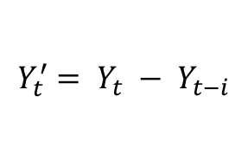
Differencing
Differencing time series is a method to help stabilize the mean and bring about stationarity
Repeated Differencing can be used to remove identifiable trends and seasonal patterns in a time series
The differenced series is a change between two equally spaced observations in a time series
Differencing on lag i
$$Y_{t}^{′}= Y_{t} − Y_{t−i}$$

Slide 24
Differencing (Air Passengers Example)
Variance Stabilized time series still shows both Trend and Seasonality
First Order Differencing (1)
Trend is Removed, but Seasonality exists
Second Order Differencing (12)
Seasonality also removed
Got Stationary Series!

Slide 25
Auto Correlation Function (ACF)
Autocorrelation is a correlation of a series with a delayed copy of itself.
It is similarities between observations as a function of time lag between them
Gradual Decay Non- Stationary
Typical of “almost” Stationary series

Slide 26
Partial Auto Correlation Function (PACF)
Partial correlation of a series with a delayed copy of itself removing effects of intermediate time lags
Sudden Cut off after 1 Lag
Sinusoidal Pattern

Slide 27
ACF & PACF for Stationary Series

Slide 28
Statistical tests for Stationarity
Ljung–Box Test
Box.test()
Examines whether there is significant evidence for non-zero correlations at lags 1-20.
Small p-values (i.e., less than 0.05) suggest that the series is stationary
Augmented Dickey-Fuller Test
adf.test()
Tests for presence of Unit Root using an Auto-Regressive Model to optimize information criteria across multiple lags
Small p-values suggest the data is stationary and doesn’t need to be differenced for stationarity.
Kwiatkowski-Phillips-Schmidt-Shin Test
kpss.test()
Accepting the null hypothesis means that the series is stationarity.
Small p-values suggest that the series is not stationary and a differencing is required.

Slide 29

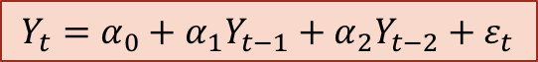
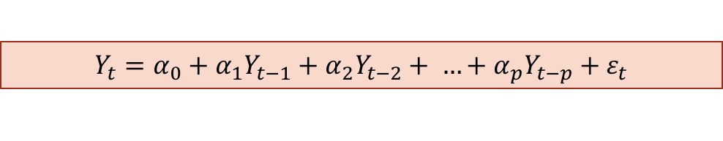
Auto Regressive Models (AR)
Once a Series is Stationary, we can use models to predict behavior
An autoregressive (AR) model predicts future behavior based on past behavior.
The process is basically a linear regression of the data in the current series against one or more past values in the same series.
AR(1) Model
AR(2) Model
$$Y_{t}=α_{0}+α_{1}Y_{t−1}+ε_{t}$$
$$Y_{t}=α_{0}+α_{1}Y_{t−1}+α_{2}Y_{t−2}+ε_{t}$$
AR(p) Model
$$Y_{t}=α_{0}+α_{1}Y_{t−1}+α_{2}Y_{t−2}+ …+α_{p}Y_{t−p}+ε_{t}$$

Slide 30
Auto Regressive - Example
New Cell Phone Demand on Launch
Gradual Decay of Demand post Launch day
Auto Regressive Model can be guessed by plotting ACF and PACF
ACF Curve | PACF Curve | Model
Exponential or Oscillating Decay | Cut off at lag ‘p’ | AR(p) Model

Slide 31
Auto Regressive Model - Selection
ACF
PACF
Exponential Decay
Cut off after lag 2, indicating AR(2) Model

Slide 32

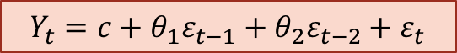
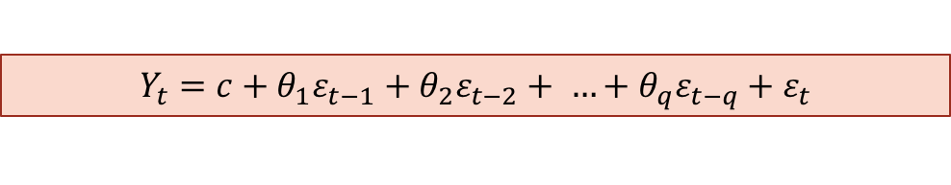
Moving Average Models (MA)
Once a Series is Stationary, we can use models to predict behavior
An moving average (MA) model predicts future behavior based on past errors
The process is basically a linear regression of the data in the current series against past forecast errors
MA(1) Model
MA(2) Model
$$Y_{t}=c+θ_{1}ε_{t−1}+ε_{t}$$
$$Y_{t}=c+θ_{1}ε_{t−1}+θ_{2}ε_{t−2}+ε_{t}$$
MA(q) Model
$$Y_{t}=c+θ_{1}ε_{t−1}+θ_{2}ε_{t−2}+ …+θ_{q}ε_{t−q}+ε_{t}$$

Slide 33
Moving Average - Example
Spike in Demand due to sudden drop in price erroneously
Shock is immediately decayed after price corrected
Moving Average Model can be guessed by plotting ACF and PACF
ACF Curve | PACF Curve | Model
Cut off at lag ‘q’ | Exponential or Oscillating Decay | MA(q) Model

Slide 34
Moving Average Model - Selection
ACF
PACF
Cut off after lag 2, indicating MA(2) Model
Exponential Decay

Slide 35
ARIMA Models
Auto Regressive Integrated Moving Average Model
The model is basically a filter which applies AR models, Differencing (I) models and MA Models to separate signal from noise. Signals are then extrapolated into future to make predictions
Order of Differencing
ARIMA(p, d, q)
Auto Regressive Terms
Moving Average Terms

Slide 36
ARIMA Model Selection

Slide 37
ARIMA Model Prediction
Log Transform the Air Passengers Series
Fit an ARIMA(1,1,0)(1,1,0)₁₂ Seasonal Model
Predict using the Model for 10 more years
Apply Exponential Transformation to Predictions

Slide 38
ARIMA Model Prediction
Use auto.arima() from forecast package to automatically select the best model
Fit the best arima model to Air Passengers
Predict using the Model using forecast() for 10 more years
Plot using plot() to get confidence intervals

Slide 39
Summary

Slide 40
Time Series Analysis
Break Time

Slide 41
Demo
Forecasting Air Passengers

